Slide 1
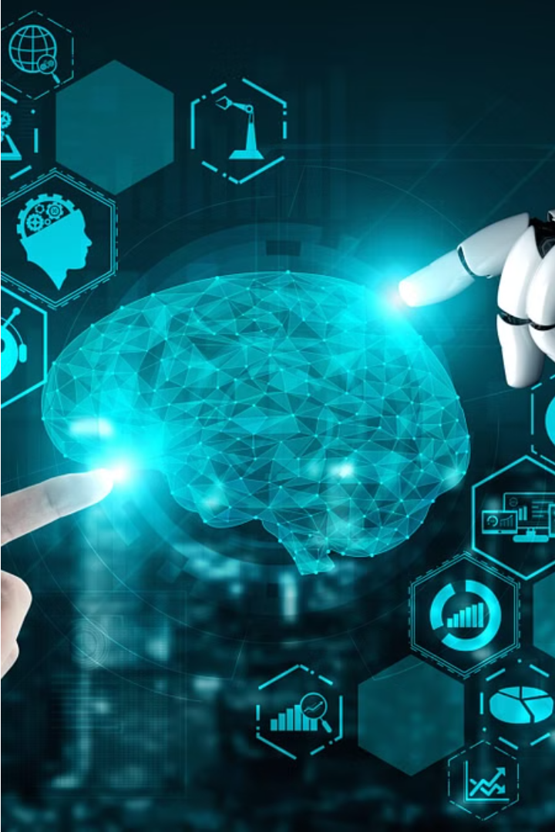
Introduction to AI & Prompt Engineering
Artificial Intelligence (AI) is a rapidly evolving field that explores the development of intelligent systems capable of performing tasks typically requiring human intelligence. Prompt Engineering is the art of crafting effective prompts to extract the desired outputs from language models like ChatGPT. This presentation will provide an overview of the key concepts, applications, and future scope of both AI and Prompt Engineering.

Slide 2
Importance & Applications of AI & Prompt Engineering
Importance of AI
Importance of Prompt Engineering
Applications
AI has the potential to revolutionize industries, automate routine tasks, and provide insights that drive innovation. It is reshaping fields like healthcare, transportation, and education.
AI and Prompt Engineering have a wide range of applications, including natural language processing, image recognition, robotics, predictive analytics, and personalized recommendations.
Prompt Engineering is crucial for unlocking the full potential of language models. Effective prompts can lead to more accurate, relevant, and coherent outputs, making AI systems more useful and reliable.

Slide 3
Key Concepts in AI
1
Machine Learning
2
Neural Networks
The ability of systems to learn and improve from data, without being explicitly programmed.
Interconnected layers of algorithms that can recognize patterns and make decisions.
3
Computer Vision
4
Natural Language Processing
The ability of systems to interpret and understand digital images and videos.
The ability of systems to analyze, understand, and generate human language.

Slide 4
Key Concepts in Prompt Engineering
Prompt Structure
Prompt Phrasing
The format and organization of a prompt to elicit the desired response from an AI system.
The choice of words, tone, and language used in a prompt to guide the AI's output.
Prompt Formatting
Prompt Iteration
The use of formatting techniques, such as bullet points or numbered lists, to improve the clarity and readability of a prompt.
The process of refining and testing prompts to optimize the quality and relevance of the AI's responses.

Slide 5

Future Scope of AI
Advancements in AI Algorithms
1
Continued improvements in machine learning algorithms, neural networks, and computing power will enable AI systems to tackle increasingly complex problems.
2
Expansion of AI Applications
AI will be integrated into more industries and domains, from healthcare and finance to transportation and entertainment.
Ethical Considerations
3
As AI becomes more advanced, there will be a growing need to address ethical concerns, such as bias, privacy, and transparency.

Slide 6




Future Scope of Prompt Engineering
Advancements in Language Models
Automation of Prompt Generation
Integration with other AI Technologies
Continuous improvements in language models, such as GPT-3 and its successors, will lead to more sophisticated and versatile prompt engineering capabilities.
The development of tools and algorithms to automatically generate and optimize prompts will streamline the prompt engineering process.
Prompt Engineering will be increasingly combined with other AI technologies, such as computer vision and robotics, to create more powerful and integrated systems.

Slide 7




AI & Prompt Engineering in Practice
Chatbots
Content Generation
Data Analysis
Task Automation
Prompt Engineering is essential for creating engaging and intelligent chatbots that can understand and respond to user queries.
Prompt Engineering can be used to generate high-quality, personalized content, such as articles, reports, and creative writing.
AI and Prompt Engineering can be leveraged to extract insights and make data-driven decisions from complex datasets.
AI-powered systems can automate a wide range of tasks, from scheduling and planning to customer service and process optimization.

Slide 8
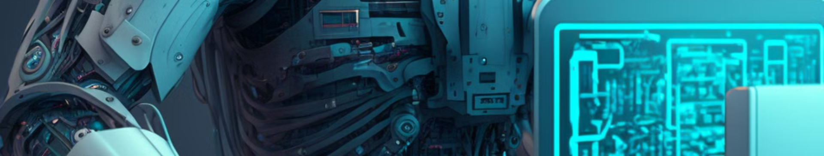
Conclusion
AI and Prompt Engineering are rapidly evolving fields with immense potential to transform industries, automate tasks, and provide valuable insights. By understanding the key concepts and exploring the future scope of these technologies, we can unlock new possibilities and drive innovation in the years to come.
Presented by
Ashlin Divya A

